Slide 1
This tool is used in pair with PgSQLMVTriggersGenV4.exe for testing trigger
Functionalities: automatically do the following:
1. Drop and re-create DB
2. Replace the old dll file in the folder /lib of PgSQL with the new one
3. Read and execute the generated sql file to create MV and setup triggers on tables
4. Import data if necessary
5. Test if the result in materialized view is the same as the result returned when we execute the original query

Slide 2
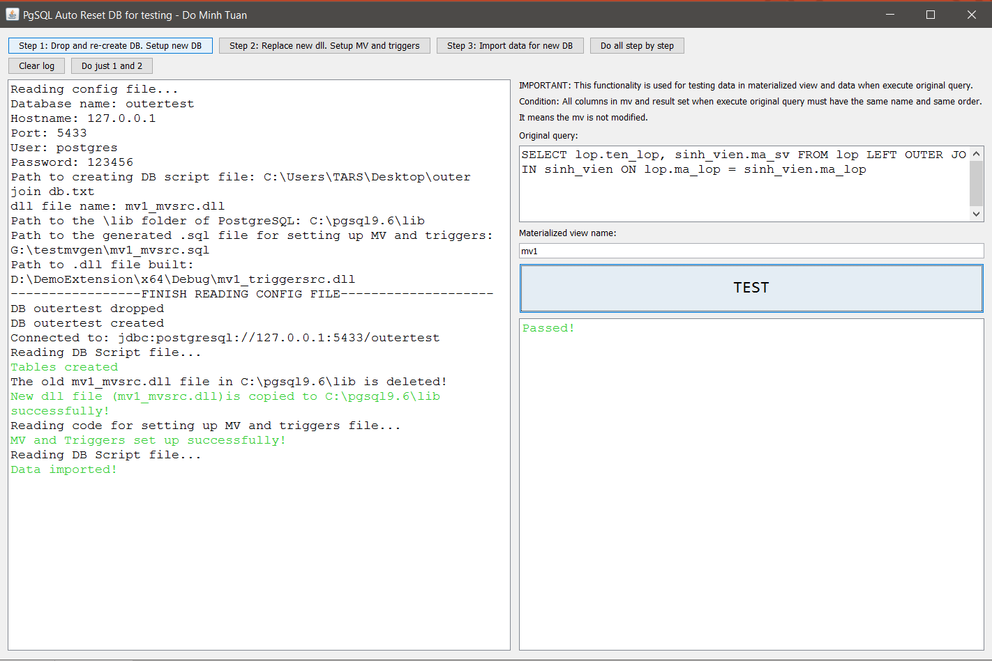
Config values, check it carefully
Result of step 1
Result of step 2
Result of step 3
Result of testing

Slide 3
Important note:
1. Any error and failed result will be displayed with RED color
2. Any success or pass messages will be displayed with GREEN color
3. Important requirement for testing functionality:
All the column in MV and in the result when execute the original query must have the same name and same order, it means the MV must not be modified.
It also means that the functionality can be used with only OUTER JOIN test, because in INNER JOIN we have the column count(*) automatically added in mv that may cause the failed of execution, or you may have to add count(*) to the original query. And if we have combined column or AVG(E), we cant use this function because they will be split into individual columns, or to SUM(E) and COUNT(E).
4. The order of lines in config.txt file:
// next slide

Slide 4
MEANING
EXAMPLE IN CONFIG.TXT
Database name
DB host
DB port
DB user
DB password
Link to script file that contains code for create database and import data (*). See (*) for more information
Name of the generated dll after built the C source code
PostgreSQL lib folder path
Path to the generated sql script file for creating MV and setting up trigger
Path to the generated dll file when we build the C source code
Name of mv
Original query
outertest
127.0.0.1
5433
postgres
123456
C:\Users\TARS\Desktop\outer join db.txt
mv1_mvsrc.dll
C:\pgsql9.6\lib
G:\testmvgen\mv1_mvsrc.sql
D:\DemoExtension\x64\Debug\mv1_triggersrc.dll
mv1
SELECT lop.ten_lop, sinh_vien.ma_sv FROM lop LEFT OUTER JOIN sinh_vien ON lop.ma_lop = sinh_vien.ma_lop

Slide 5
(*) file that contains code for create database and import data
1. The code for creating DB must be placed before the code for importing data
2. If any constraint exists, it should be place in the correct order. For ex: LOP 1 – n SV, fk sv.ma_lop references lop(ma_lop), so the script to create the table LOP should be placed before the table SVs
3. Script for creating DB and importing data is devided by:
‘…..
---Devider
…..’
See next slide for example
If in the script file we have any comment(s), please put them inside “/*…*/”, not “--”. Because the script will be combined before execution so if use “--”, you will comment all the script from that line.

Slide 6
Sample DB file
create table lop(
ma_lop integer,
ten_lop character varying (30),
CONSTRAINT pk_lop PRIMARY KEY (ma_lop)
);
create table sinh_vien (
ma_sv integer,
ma_lop integer,
ten_sv character varying (50),
CONSTRAINT pk_sv PRIMARY KEY (ma_sv),
CONSTRAINT fk_sv_lop FOREIGN KEY (ma_lop)
REFERENCES lop (ma_lop) MATCH SIMPLE
ON UPDATE CASCADE ON DELETE CASCADE
);
---Devider
insert into lop values (1, 'Ten Lop 1');
insert into lop values (2, 'Ten Lop 2');
insert into lop values (3, 'Ten Lop 3');
insert into sinh_vien values(1, 1, 'Sinh vien 1');
insert into sinh_vien values(2, 1, 'Sinh vien 2');
insert into sinh_vien values(3, 3, 'Sinh vien 3');
insert into sinh_vien values(4, 2, 'Sinh vien 4');
insert into sinh_vien values(5, 2, 'Sinh vien 5');
insert into sinh_vien values(6, 1, 'Sinh vien 6');

